Slide 1
Research opportunities
prep programs

Slide 2
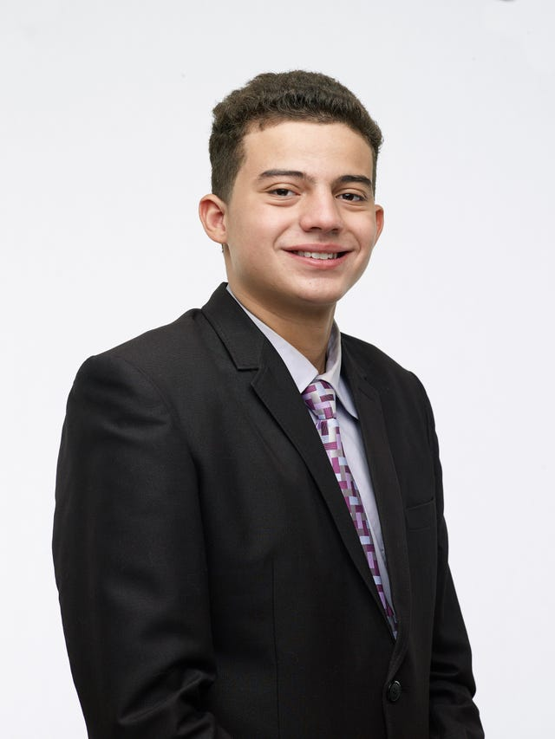
About ME
Hi!!! I am Abdalrahman Elaksher
Junior in Chemical Engineering
I have been doing research since Junior year in high school
Currently I am working in Dr. Bakers Analytical Chemistry Lab under a Space Grant and AMP stipend
Most recently I spent the summer working on a research project at UNC at Chapel Hill neuroscience center
Why am I here? To talk to you about undergraduate research!!

Slide 3
New Mexico Space Grant Consortium
UNDERGRADUATE RESEARCH SCHOLARSHIP
$5,000 scholarship for two academic semesters
Conduct a research project of interest to NASA’s mission directorates
Reach out to a faculty to start working on a proposal
Next application cycle opens January 2023.
http://nmspacegrant.com/undergraduate-research-scholarship/
Email: nmsgc@nmsu.edu
Phone: 575-646-6414

Slide 4
MARC Program
MARC Fellow
Stipend and Summer Research Opportunity
Great if you are interested in a MD/PhD or something similar
Email MARC to get more information
Deadline is Typically April
https://marc.nmsu.edu/
mruthven@nmsu.edu
Call the MARC Program 575-646-3476
Stop by the office in Chemistry room W292

Slide 5
AMP PREP
STEM PREP program
Stipend
Great opportunity for new researchers
Help you find a mentor and learn how to do research
Great segue into AMP URS
Applications are open until August 31, 2022.
https://nmamp.nmsu.edu/index.html
Phone: (575) 646-1847
Email: nmamp@nmsu.edu

Slide 6
AMP URS
URS program
Stipend
Great opportunity for paid research
Work on any STEM related project
Have your own project
Applications are open until August 31, 2022.
https://nmamp.nmsu.edu/index.html
Phone: (575) 646-1847
Email: nmamp@nmsu.edu

Slide 7
NSF REU
Summer Undergraduate Researcher
Stipend, relocation, and housing
Great opportunity for paid research and to see a new place
Professional networking and career development
Options across almost all disciplines
Conference grant upon completion
Applications are typically due February/March
https://www.nsf.gov/crssprgm/reu/reu_search.jsp

Slide 8
REACH out!!!!
You cannot be afraid to send email!!! Loads of them.
Start off volunteering it’s a great way to get experience
Look up the faculty lists for any department you might be interested in
Read professors projects and SEND emails
Pick a project you have real interest in and show it!!!
I reached out to many professors just to get a few responses
Volunteered in high school in order to get these opportunities
Feel free to email me at any time if you have any questions or need any help finding a professor to work with
My email: abdelak@nmsu.edu

Slide 9
Bonus: Post-Bac Programs
Graduating might seem like a while away but before you know you’ll be wondering what you'll do next
These programs are great if research interests you and a great transition to elite PhD programs
https://nigms.nih.gov/training/PREP/Pages/prep-grads.aspx
https://www.training.nih.gov/programs/postbac_irta
Research Technician

